Slide 1
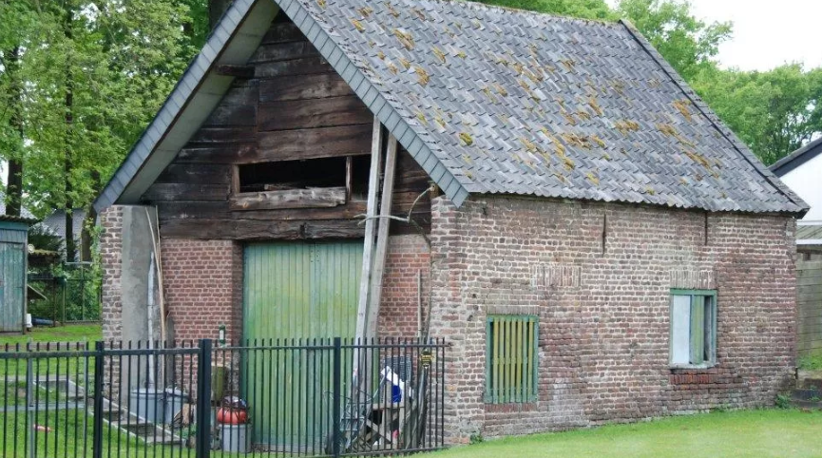
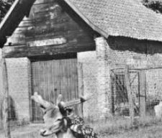
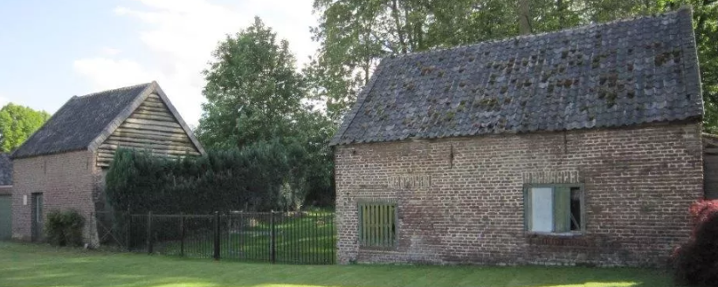
Rebuilding the historic Rosoliemolen (Regina)
"horse-driven oil mill"

Slide 2
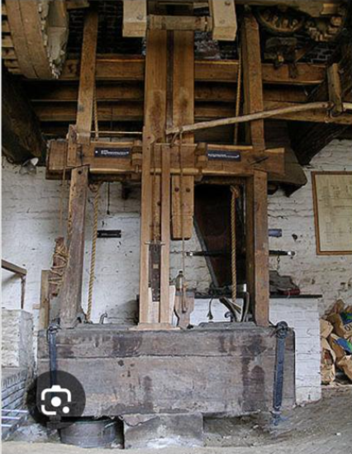
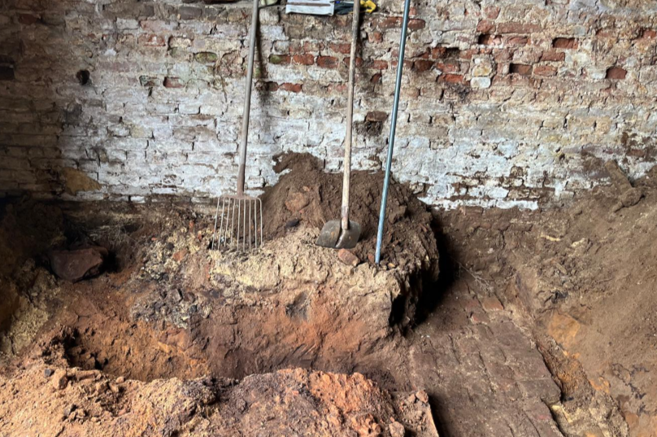
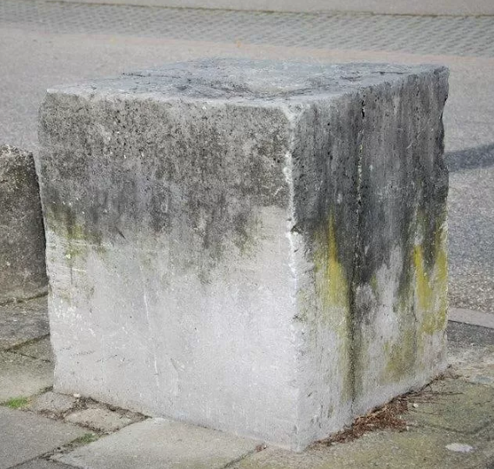
Rebuilding the historic Rosoliemolen "horse-driven oil mill"
example
A beater/hitting bench (slagbank ) is a historical tool used to crush, flax seed/oil seed materials. It was often part of a horse mill—a mill powered by a horse.
here one sees an example of a similar object
Part recovered during the excavations
A large stone block served as a stable base for the hammer bench. Because the rams exerted a lot of force, the foundation had to be strong and heavy to absorb vibrations and hold the structure in place.
Fundament from oildrip

Slide 3
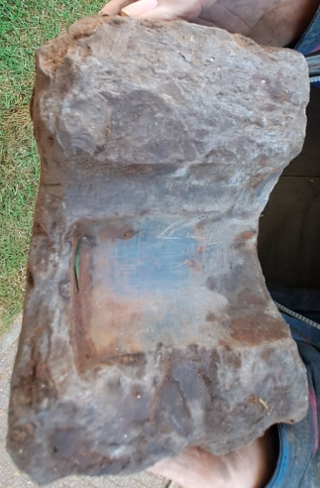
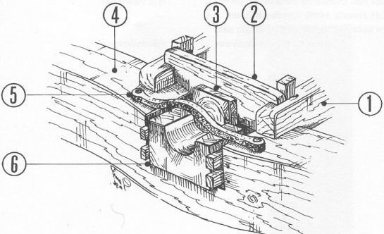
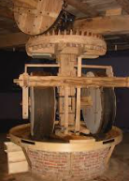
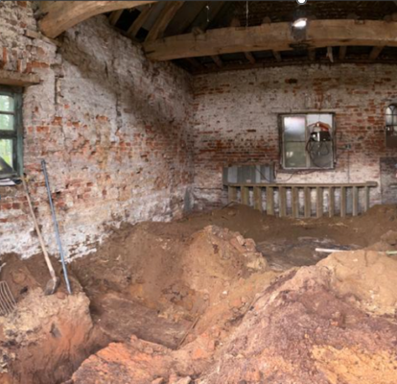
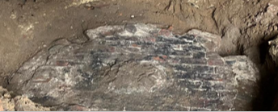
example
Part recovered during the excavations
-Above the Pen stone
-down the fundament from millstone's

Slide 4
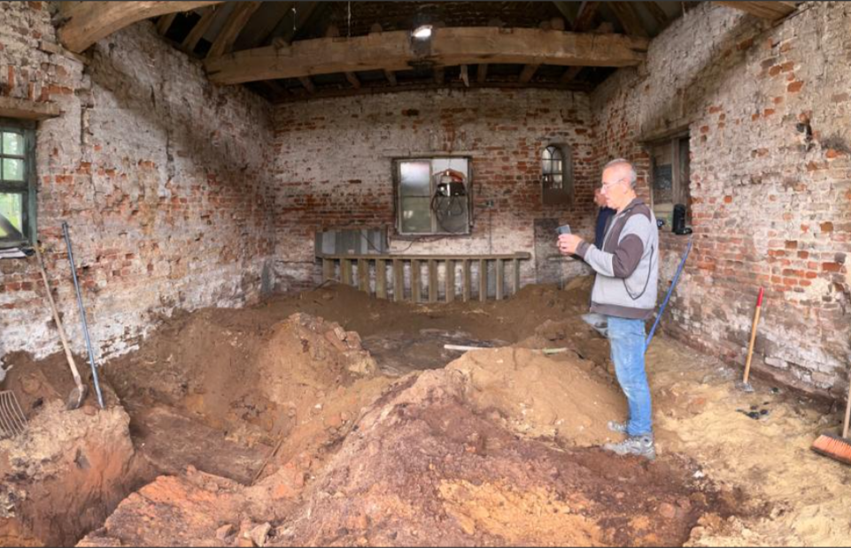
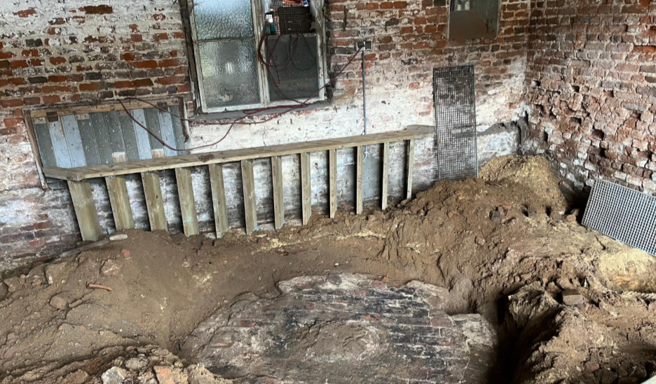
We have now been able to
uncover two foundations,
One for the beater/hitting bench (slagbank ) collecting container
One for probably the milestones

Slide 5
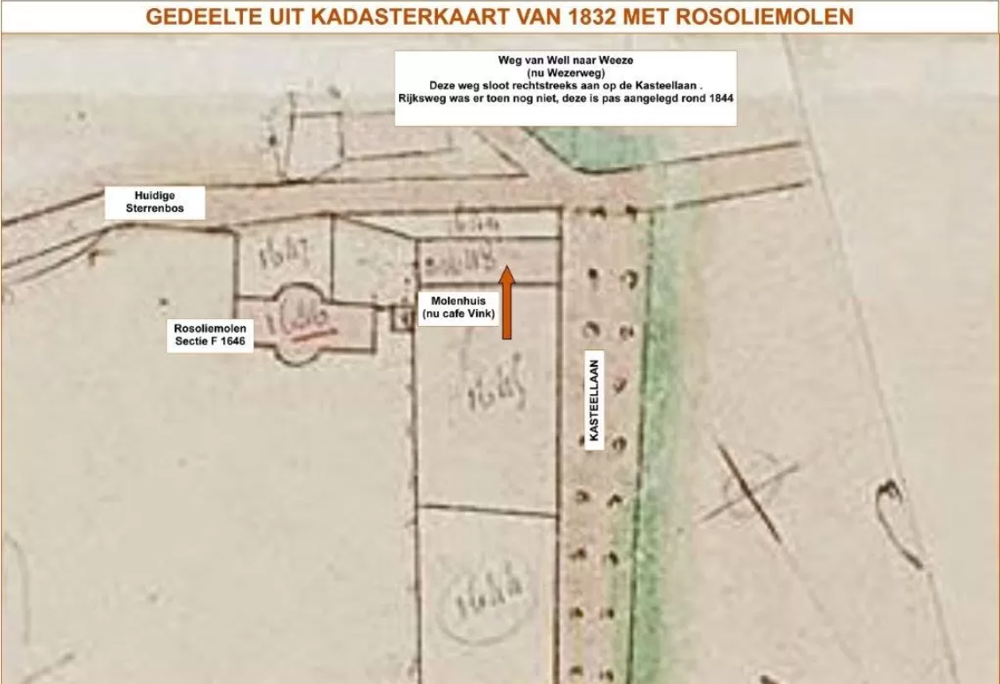
The oldest document in which it was mentioned is of a horse mill dating from 1580. It is an invoice for its construction.

